Slide 1

React Native on the Universal Windows Platform
Erik Schlegel
Sr. Engineer – Microsoft - Developer Experience
@erikschlegel1

Slide 2
What is React?
var HelloWorld = React.createClass({
render: function() {
return (
<p>
Hello, <input type="text" placeholder="Your name here" />!
It is {this.props.date.toTimeString()}
</p>
);
}
});
setInterval(function() {
ReactDOM.render(
<HelloWorld date={new Date()} />,
document.getElementById('example')
);
}, 500);

Slide 3
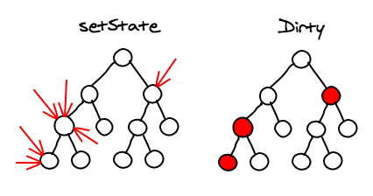
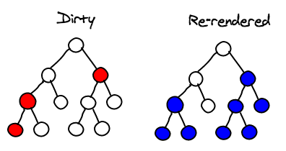
What is React?
Images Credit: @vjeux

Slide 4
What is React Native?
“React Native enables you to build world-class application experiences on native platforms using a consistent developer experience based on JavaScript and React.”

Slide 5
What is React Native?
“Write once, run anywhere”
“Learn once, write anywhere”

Slide 6


Horizontal Platform
APIs and Paradigms
Tools and Languages
Code (80%)
React
React
React Native
React Native
iOS
Android
UWP
…
iOS
Android
UWP
…
Web
Web
Share when possible, go native when necessary

Slide 7


Mobile Cross-Platform Options
Notes:
- Hybrid mobile app frameworks are everywhere,
Frameworks like Xamarin give you native performance across iOS and Android with .NET so...
Xamarin is an enticing option.
Why React Native?
- Unlike Xamarin, React Native give you access to Web-like release agility with tools like CodePush and Exponent...
- Similar to Cordova, your HTML and JavaScript skills transfer over to native app development...
- Similar to the way Xamarin, which gives you access to existing libraries out their on NuGet, React Native gives you access to a wealth of JavaScript modules on NPM
- Similar to Xamarin, the views that are rendered in your apps are real native views, not just Web views with access to runtime APIs as in Cordova.

Slide 8


React Community
275,000+ users of React Chrome Extension
30,000+ GitHub stars
700+ React Native contributors
500+ Third Party Modules @ http://react.parts

Slide 9
What is React Native?
Native Views
Asynchronous Execution
Touch Handling
Flexbox & Styling
Extensibility

Slide 10
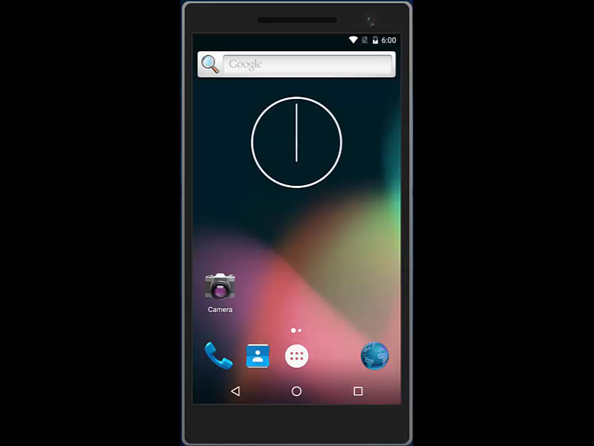
React Native Demo

Slide 11
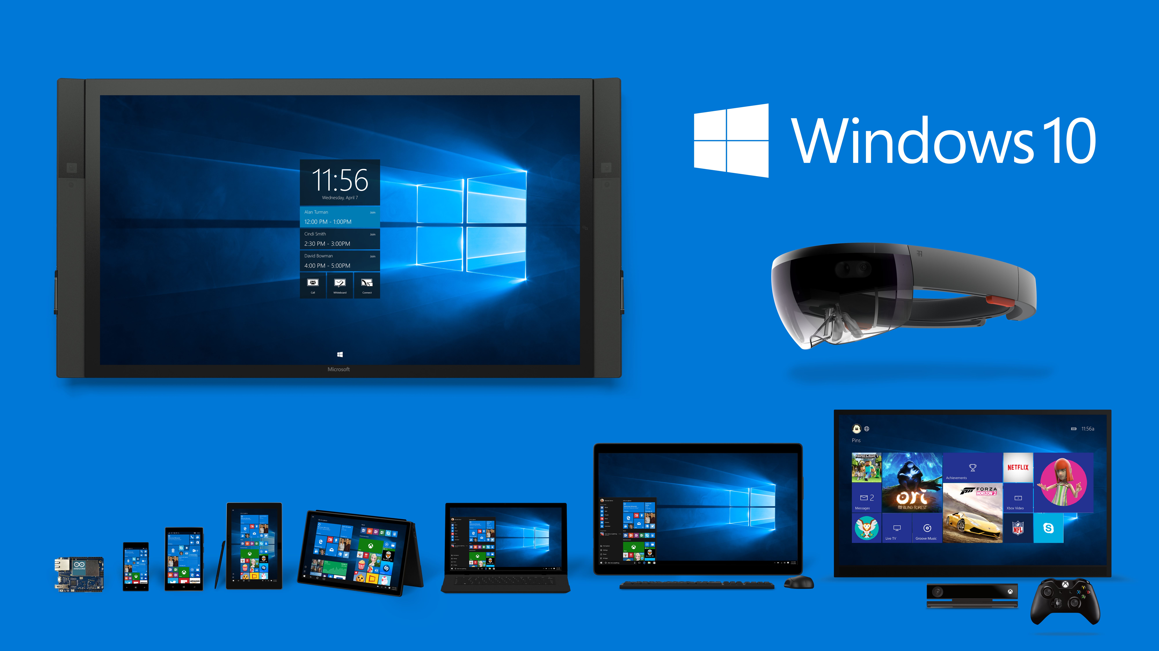
Notes:
There is over 300 million windows 10 devices out there rightnow.

Slide 12
What language will be used?
Framework Extensibility
Platform Symmetry
Native Performance

Slide 13
What native view framework will be used?
Web View?
Windows.UI.Composition?
Windows.UI.Xaml.UIElement ✔
public interface IViewManager
{
string Name { get; }
void UpdateProperties(
FrameworkElement viewToUpdate,
ReactStylesDiffMap props);
FrameworkElement CreateView();
void OnDropViewInstance(
FrameworkElement view);
void UpdateExtraData(
FrameworkElement root,
object extraData);
void ReceiveCommand(
FrameworkElement view,
int commandId,
JArray args);
}

Slide 14
What JavaScript runtime will be used?
var globalObject = JavaScriptValue.GlobalObject;
var requireFunction = globalObject.GetProperty(
JavaScriptPropertyId.FromString("require"));
var moduleName =
JavaScriptValue.FromString("MyModule");
var module = requireFunction.CallFunction(
globalObject,
moduleName);
var value = JavaScriptValue.CreateObject();
value.SetProperty(
JavaScriptPropertyId.FromString("foo"),
JavaScriptValue.FromInt32(42),
true);
JavaScriptContext.RunScript(
"var myModule = require('MyModule'); " +
"var value = { 'foo': 42 };");
JavaScriptCore?
Chakra ✔

Slide 15
How are the native threads managed?
JavaScript and Layout Threads
UI Thread
private readonly taskScheduler =
new LimitedConcurrencyTaskScheduler(1);
private readonly taskFactory =
new TaskFactory(taskScheduler);
public async void RunOnQueue(Action action)
{
await taskFactory.StartNew(() =>
{
try
action();
catch (Exception ex)
ShowRedBoxException(ex);
});
}
private readonly actionObservable =
new Subject<Action>();
private readonly subscription =
actionObservable
.ObserveOnDispatcher()
.Subscribe(action =>
{
try
action();
catch (Exception ex)
ShowRedBoxException(ex);
});
public async void RunOnQueue(Action action)
{
actionObservable.OnNext(action);
}

Slide 16
How are native modules registered?
class ClipboardModule : NativeModuleBase
{
public override string Name
{
get
{
return "Clipboard";
}
}
[ReactMethod]
public void setString(string text)
{
RunOnDispatcher(() =>
{
var package = new DataTransfer.DataPackage(text); DataTransfer.Clipboard.SetContent(package);
class FooViewManager : SimpleViewManager<Canvas>
{
public override string Name => "Foo";
[ReactProp("Bar")]
public void SetBar(string qux)
{
/* ... */
}
protected override Canvas CreateViewInstance(
ThemedReactContext reactContext)
{
return new Canvas();
}
}
Notes:
Expose native methods to JavaScript runtime
E.g., Timers, Local Storage, Toast, GPS, Bluetooth, …
Using reflection, application host

Slide 17
How are native modules registered?
public interface IReactPackage
{
ReadOnlyList<INativeModule> CreateNativeModules(ReactContext reactContext);
IReadOnlyList<IViewManager> CreateViewManagers(ReactContext reactContext);
IReadOnlyList<Type> CreateJavaScriptModulesConfig();
}
public class MainReactPackage : IReactPackage
{
public IReadOnlyList<IViewManager> CreateViewManagers(
ReactContext reactContext)
{
return new List<IViewManager>
{
new ReactFlipViewManager(),
new ReactProgressBarViewManager(),}

Slide 18

What is the native developer experience?
Notes:
With the RM dev tools you shorten the feedback loop between seeing your changes live in realtime.
CI - JavaScript deployment is much faster and less disruptive than publishing your app to the App Store. With this you're always releasing
Code Push

Slide 19
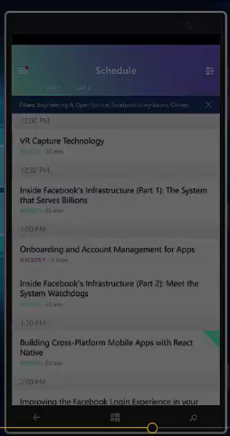
Bringing F8 App to Windows
3 developers, 3 weeks
Most time spent filling in missing modules…
SplitView, FlipView, Clipboard, AsyncStorage, …
react-native-fbsdk, react-native-share
< 1 week for style adaptation only

Slide 20
Bringing F8 App to Windows
F8TabsView.windows.js
F8TabsView.android.js
class F8TabsView extends React.Component {
...
render() {
return (
<F8SplitView
ref="splitView"
paneWidth={290}
panePosition="left"
renderPaneView={this.renderPaneView}>
<View
style={styles.content}
key={this.props.tab}>
{this.renderContent()}
</View>
</F8SplitView>
);
}
...
}
class F8TabsView extends React.Component {
...
render() {
return (
<F8DrawerLayout
ref="drawer"
drawerWidth={290}
drawerPosition="left"
renderNavigationView={this.renderNavView}>
<View
style={styles.content}
key={this.props.tab}>
{this.renderContent()}
</View>
</F8DrawerLayout>
);
}
...
}
var styles = StyleSheet.create({
container: {
flex: 1,
backgroundColor: 'white',
},
listView: {
ios: {
backgroundColor: 'transparent',
},
android: {
backgroundColor: 'white',
},
windows: {
backgroundColor: 'white',
}
},
headerTitle: {
color: 'white',
fontWeight: 'bold',
fontSize: 20,
},
});

Slide 21
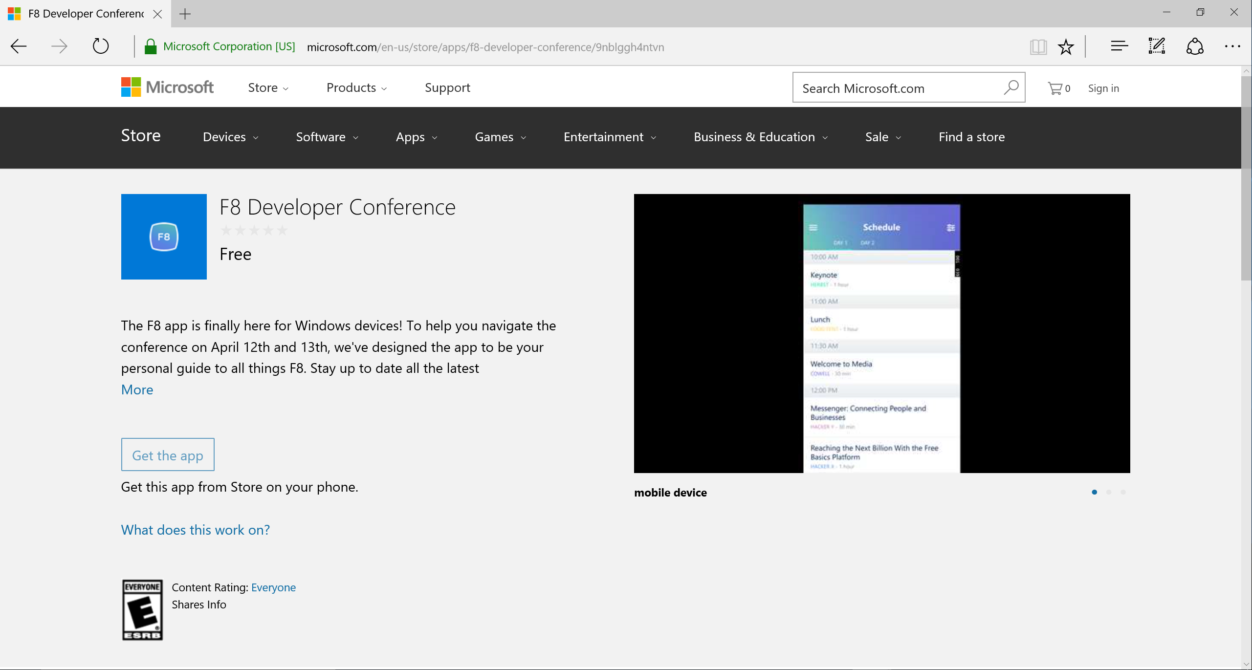
Notes:
- Some stuff about shipping on the app store
- .NET Native
- Reflection issues, JSON serializer issues, etc.

Slide 22
Cross Stack Engineering
React Native can transform product organizations.
Notes:
Allows you to structure your dev team across features and apis as opposed to OS's
i.e. Image gallery across all three platforms
Easier for devs to transition from feature to feature as opposed to platform to platform.
Build a team of inquisitive devs that like to look under the hood, open to using techs like react and have mobile dev experience
Cross stack engineering.
Changes the way we organize our dev projects and hire teamsters

Slide 23

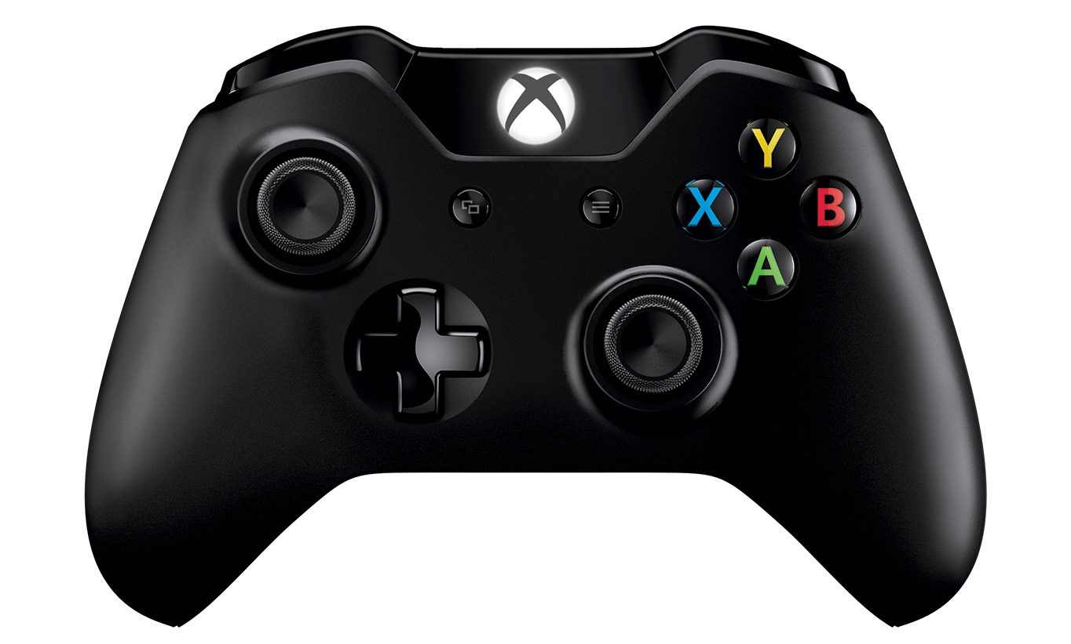
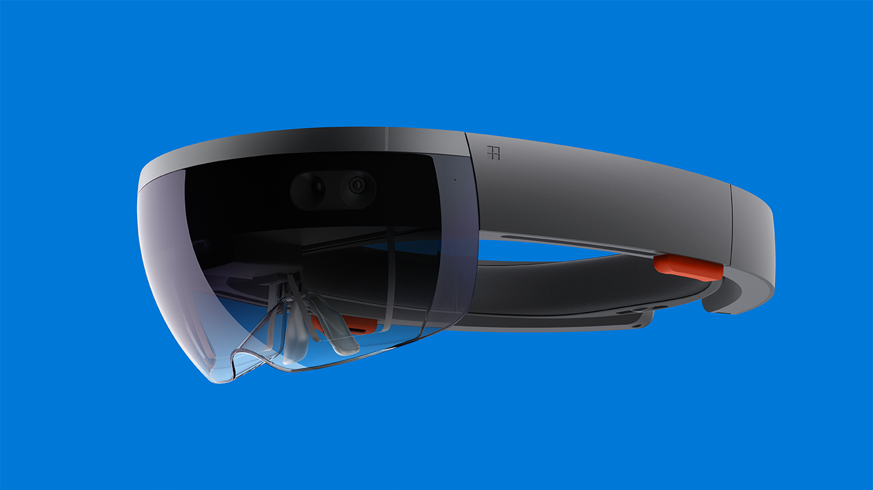

What lies ahead?
Notes:
- React Native Desktop / Xbox paradigms
- Plans for moving forward on OSS contribution
- Call to action

Slide 24
Open Source
http://github.com/ReactWindows/react-native
http://github.com/ReactWindows/f8app
Notes:
- React Native Desktop / Xbox paradigms
- Plans for moving forward on OSS contribution
- Call to action

Slide 25
Thank you!
Erik Schlegel
@erikschlegel1

